Slide 1
Statistical Analysis
EEOB590A
Fall 2021

Slide 2
Analysis pathway
Explore data
Model development & selection
Univariate/multivariate
Error distribution
Random effects
Interactions
Assess model fit (go back to #1 if poor fit)
Interpret results
Notes:
General process (linear) explore data, model development, assess model fit and interpret

Slide 3
1. Explore data
Remember, the goal is to know your dataset inside & out.
If you decide to use a different subset of data, then you need to repeat this process
Summarize your findings at the end of your data exploration portion of the script.

Slide 4
2. Model. Development and Selection
2.1: Decide whether univariate, multivariate, or something else
Data exploration
multivariate
Univariate
Multiple response variables
Single response variable
Other options: time series, non-linear models, mark-recapture, distance sampling, path analysis etc.
Notes:
One vs multiple response variable

Slide 5
Multivariate
Analyze data for differences
View data only
With explanatory variables
Without explanatory variables
ordination
Redundancy Analysis (RDA)
Canonical Correspondence Analysis (CCA)
Principal Coordinates Analysis (PCA)
Discriminant Analysis
Non-metric multidimensional scaling (NMDS)
Packages (statistical tests):
vegan (adonis, anosim)
mvabund (manyglm)
rrpp (anova.lm.rrpp)
Notes:
Ordination → another way to view the data
The circle graph with spots

Slide 6
Data types
Species
Presence/absence, ordinal, count, biomass, percentage cover
Environmental
Soil, geological, oceanographic, climate
Morphological/Traits
Size or shape measurements, life history traits, sex, etc.
Survey/Questionnaire
Nominal, ordinal, measurements

Slide 7
All ordination methods are based on similarity distance matrix constructed on your data, using different methods (such as Euclidean, Bray-Curtis (=Sorensen), Jaccard etc.) to calculate the distance between samples.
Notes:
Break out Jaccard
Euclidean
Bray-Curtis
Distance matrix is the first step in setting up a multivariate matrix

Slide 8
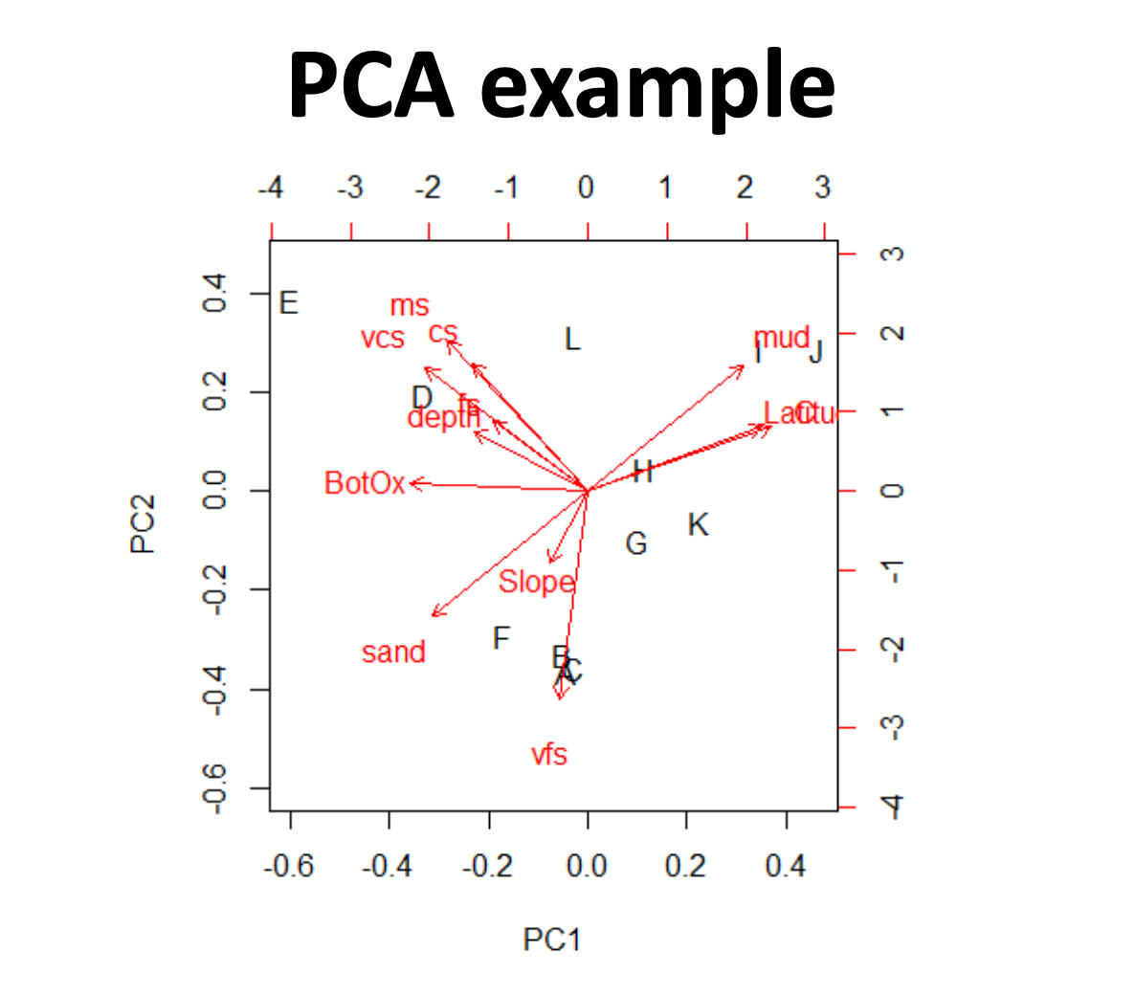
NMDS example
For quantitative variables
Ant communities
manyglm(ants ~ foresttreatment)
Notes:
https://www.researchgate.net/publication/323595420_Identifying_foundation_species_in_North_American_forests_using_long-term_data_on_ant_assemblage_structure/figures?lo=1
Ordination figure**
NMDS and PCA

Slide 9

Univariate: Linear Model Structure

Slide 10
Step 2.2: Linear models: select the appropriate structure
Notes: Assuming you have a univariate response, a linear relationship, and have explored data for normality, outliers, collinearity, start here to determine your model structure.

Slide 11
Linear models: select the appropriate structure
Decide on error distribution, which is coded as “family = ___”. If non-normally distributed, then will need to use a GLM or generalized linear model.

Slide 12
Linear models: select the appropriate structure
Decide whether you will include random effects, which are typically coded in lme4 package as (1|randomeffect). If you include random effects, then you will need a mixed effects model (lmer).

Slide 13
Linear models: selecting the appropriate structure
Decide whether to include interactions in the main effects. These are coded as fixedeffect1*fixedeffect2.
Notes:
Model the slopes of treatment and control averages and if they intersect there is an interaction between the 2 variable and th e
Type of model you will be working with, uni vs multi
Random effects vs fixed
Non-normally distribute error
Linear model, univariate and non-normally distributed error

Slide 14
I have my model. Now how do I test my hypothesis?
I designed & executed an experiment, perhaps in multiple contexts.
Fit full model. No model selection, except removing nonsignificant interactions. (Philip’s preference)
Information Theoretic approach: Use AIC/BIC to select best-fitting model.
I did an observational study, where I was testing a primary variable, but need to figure out which confounding variables to include.
Use model selection on possible confounding variables based on AIC/BIC, then add primary variable.
Classic model selection: Fill full model and appropriate submodels. Use Likelihood Ratio Tests to identify best-fitting model.
I did an observational study, and I am trying to figure out which variables predict Y.
Use model selection on an a priori chosen list of models or all subsets and evaluate using AIC/BIC.
Classical hypothesis testing: Fit full model; sequentially remove non-significant interactions then main effects until all remaining variables are significant.
Step 2.3: Model selection options

Slide 15
3: Assess model fit
Four key assumptions to check for in a linear model.
Independence of observations
Linearity between the response variable and the predictor variables
Constant variance of the residuals
Normality of the residuals

Slide 16
3.1: Independence of observations
This is best assessed by considering the study design.
Is each row independent of all other rows? If not, do you have a random or fixed effect representing these grouping variables?

Slide 17
3.2: Linearity, variance, normality
Use fitted vs residuals, Q-Q plot, index plot, and histogram of residuals to examine model fit

Slide 18
Residual Plot (upper left): This is a plot of the residuals versus predictive values from the model to assess the linearity and constant variance assumptions. Should lack patterns, so look for curvature or patterns in the data as a sign that there may be a problem with model fit.

Slide 19
Normal Quantile Plot (upper right): Also known as a qq-plot, this plot allows us to assess the normality assumption. Should follow the 1:1 line. Deviation from this is a sign that the model may not fit well.

Slide 20
Index Plot (lower left): This is a plot of the residuals versus the observation numbers. It can help to find patterns related to the way that the data has been ordered, which may provide insights into additional trends in the data that have not been accounted for in the model. Shouldn’t see any patterns.

Slide 21
Histogram (lower right): This is a histogram of the residuals with an overlaid normal density curve with mean and standard deviation computed from the residuals. It provides an additional way to check the normality assumption. Should be centered around zero and symmetrical.

Slide 22
What do I do if my model doesn’t fit well?
Figure out why:
Normality problems (Residual plot, Q-Q plot, histogram) - perhaps you are using the wrong error distribution. Run model with a more appropriate one, and see if it improves.
Linearity problems (residual plot, index plot) – Is there a temporal cycle or spatial pattern not included in the model? Add term or use different model.
Variance problems (residual plot, index plot) - consider a different error distribution.
Outliers – consider dropping points with high leverage and re-running.

Slide 23
I have my model. Now how do I test my hypothesis?
I designed & executed an experiment, perhaps in multiple contexts.
Fit full model. No model selection, except removing nonsignificant interactions. (Philip’s preference)
Use model selection based on AIC/BIC to choose best-fitting model.
I did an observational study, where I was testing a primary variable, but need to figure out which confounding variables to include.
Use model selection on possible confounding variables based on AIC/BIC, then add primary variable.
Fill full model and appropriate submodels. Use Likelihood Ratio Tests to identify best-fitting model.
I did an observational study, and I am trying to figure out which variables predict Y.
Use model selection on an a priori chosen list of models or all subsets and evaluate using AIC/BIC.
Interpret main effects, interactions, and simple effects when necessary.
Use emmeans or glht to determine significance between levels and get a p-value.
Use confidence intervals to determine which coefficients are important predictors.
Note – not appropriate for most GLMM’s.
Get a p-value describing which model fits best.
Discuss the variables that are included in best fitting model. You do not get a p-value as output. And it’s difficult to identify differences between levels of a factor.
Fit full model; sequentially remove non-significant interactions then main effects until all remaining variables are significant.
Interpret main effects, interactions, and simple effects when necessary.
Use emmeans or glht to determine significance between levels and get a p-value.
Discuss the variables that are included in best fitting model. You do not get a p-value as output. And it’s difficult to identify differences between levels of a factor.
Discuss the variables that are included in best fitting model. You do not get a p-value as output. And it’s difficult to identify differences between levels of a factor.
Step 4: Interpreting results

